Slide 1
Software Testing Strategies
Software Engineering: A Practitioner’s Approach, 7th edition
by Roger S. Pressman

Slide 2
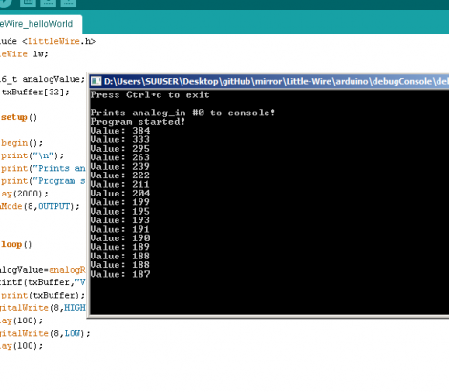
How do you debug a program
By writing a lot (!) of printf

Slide 3
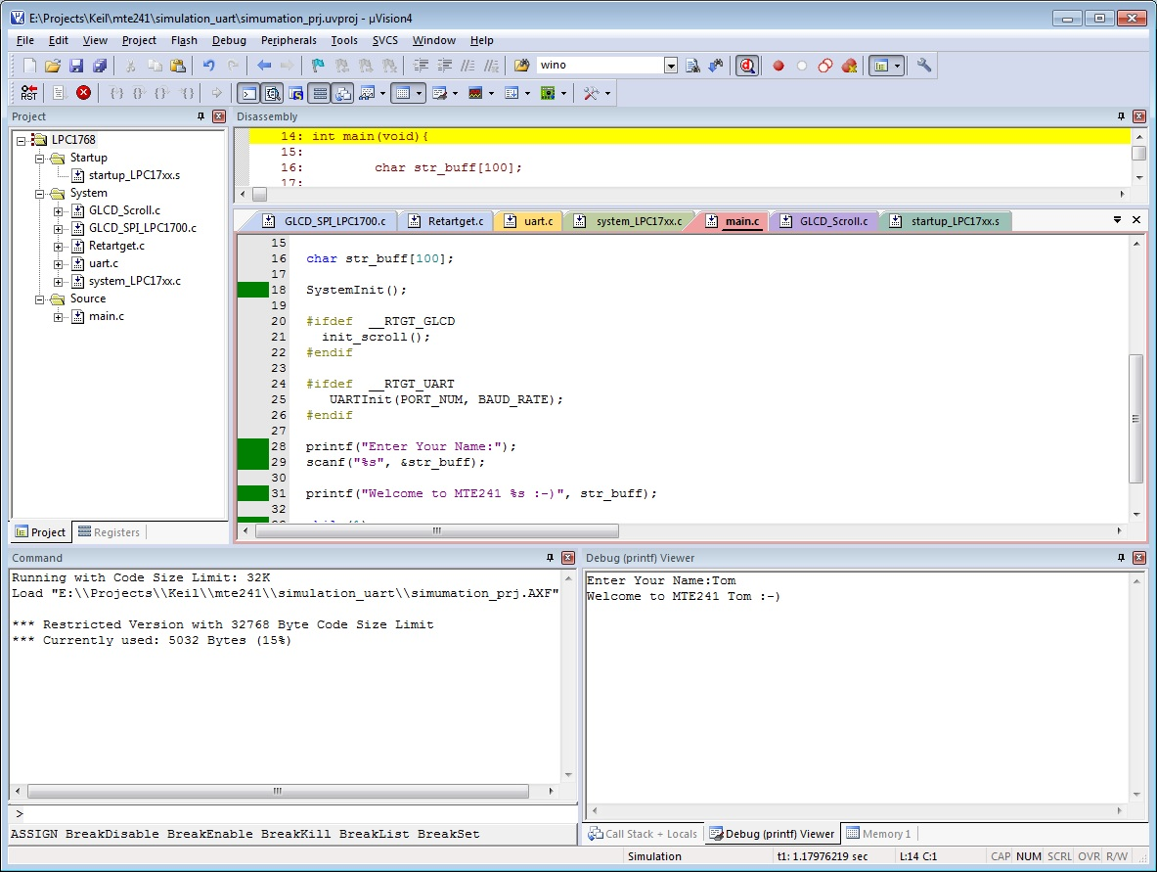
How do you debug a program
By using debugging tools

Slide 4
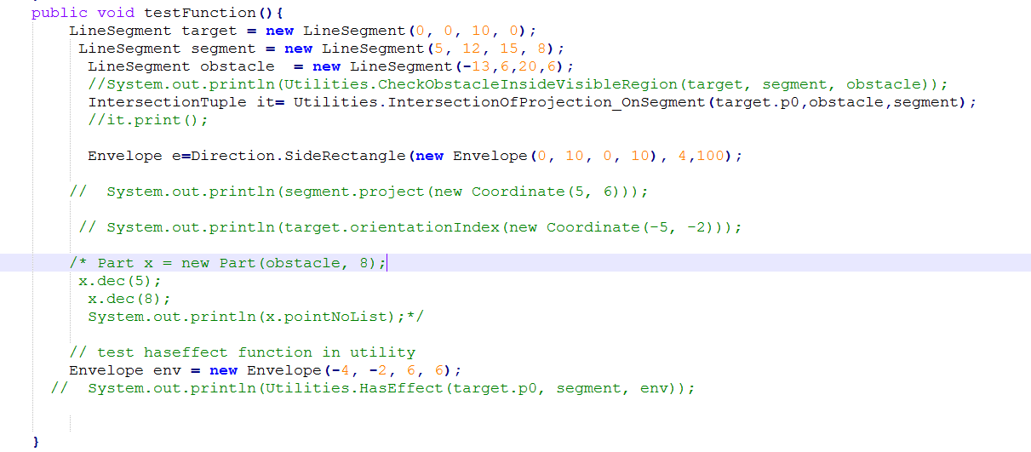
How do you debug a program
By writing a separate test function

Slide 5
Software Testing
Testing is the process of exercising a
program with the specific intent of finding
errors prior to delivery to the end user.
Notes:
Software testing is the process of analyzing a software item to detect the differences between existing and required conditions (i.e., bugs) and to evaluate the features of the software item.

Slide 6
What Testing Shows
errors
requirements conformance
performance
an indication
of quality

Slide 7

Software quality control techniques
Fault avoidance: prevents errors before the system is released.
reviews, inspections, walkthroughs, development methodologies, testing, verification
Fault tolerance: enables the system to recover from (some classes of) errors by itself.
rollbacks, redundancy, mirroring

Slide 8
Who Tests the Software?
developer
independent tester
Understands the system
Must learn about the system,
but, will test "gently"
but, will attempt to break it
and, is driven by "delivery"
and, is driven by quality

Slide 9
Verification & Validation
Verification is the process of evaluating a system or component to determine whether the products of a given development phase satisfy the conditions imposed at the start of that phase.
Are we building the product right?
Testing, Reviews
Is the code correct with respect to its specification?
Validation is the process of evaluating a system or component during or at the end of the development process to determine whether it satisfies specified requirements.
Are we building the right product?
Comparison against requirements
Does the specification reflect what it should?

Slide 10
Terminology
Mistake – a human action that produces an incorrect result.
Fault [or Defect] – an incorrect step, process, or data definition in a program.
Failure – the inability of a system or component to perform its required function within the specified performance requirement.
Error – the difference between a computed, observed, or measured value or condition and the true, specified, or theoretically correct value or condition.

Slide 11

Exception or error output expected
Error
Overflow / crash
Failure
int factorial(int a){
if(a==1)
return 1;
return a* factorial(a-1);
}
Lack of input validation
Defect: missing validation
Mistake: Did not consider numbers less than 1

Slide 12
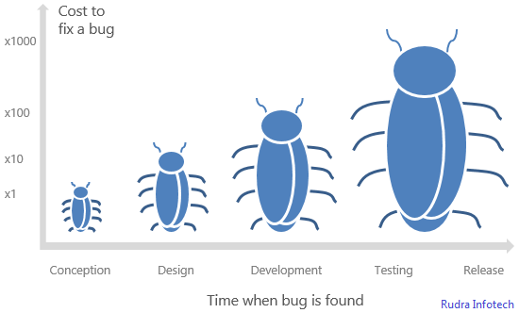
When should we test software?
Answer: Throughout the whole development process

Slide 13
Testing goals
Write test cases to cause failures.
But, there is no way to guarantee that all faults have been detected.
Work smart: write as few test cases as possible to cause failures; don’t have more than one test cause the same failure

Slide 14
Software Testing
white-box
methods
black-box
methods
Methods
Strategies

Slide 15
Black-Box Testing
requirements
output
input
events

Slide 16
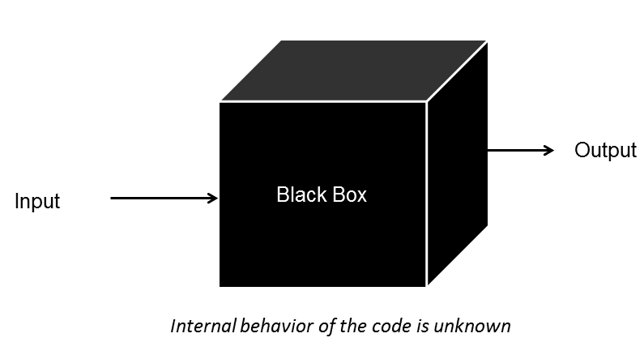
Testing model: Black box testing
Black box testing: ignores the internal mechanism of a system or component and focuses solely on the outputs generated in response to selected inputs and execution conditions.
Interface visible, internals unknown
You know what it is supposed to do, you design tests that make it do what you think that it should do
From the outside, you are testing its functionality against the specs
For software this is testing the interface
What is input to the system?
What you can do from the outside to change the system?
What is output from the system?
Tests the functionality of the system by observing its external behavior
No knowledge of how it goes about meeting the goals

Slide 17
Advantages of Black box testing
Process is not influenced by component being tested
Assumptions embodied in code not propagated to test data.
Robust with respect to changes in implementation
Test data need not be changed when code is changed
Allows for independent testers
Testers need not be familiar with code
Useful for validation (are we building the right software)

Slide 18
Disadvantages of Black box testing
It will miss bugs in the implementation that are not covered by the specification
Control-flow details
Performance optimizations
Alternate algorithms for different cases

Slide 19
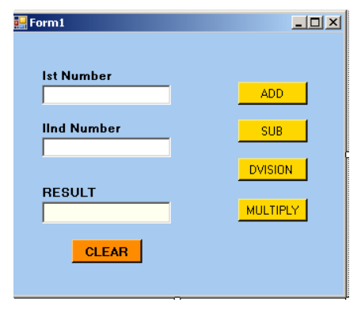
Sample scenario
How to test this sample form?

Slide 20
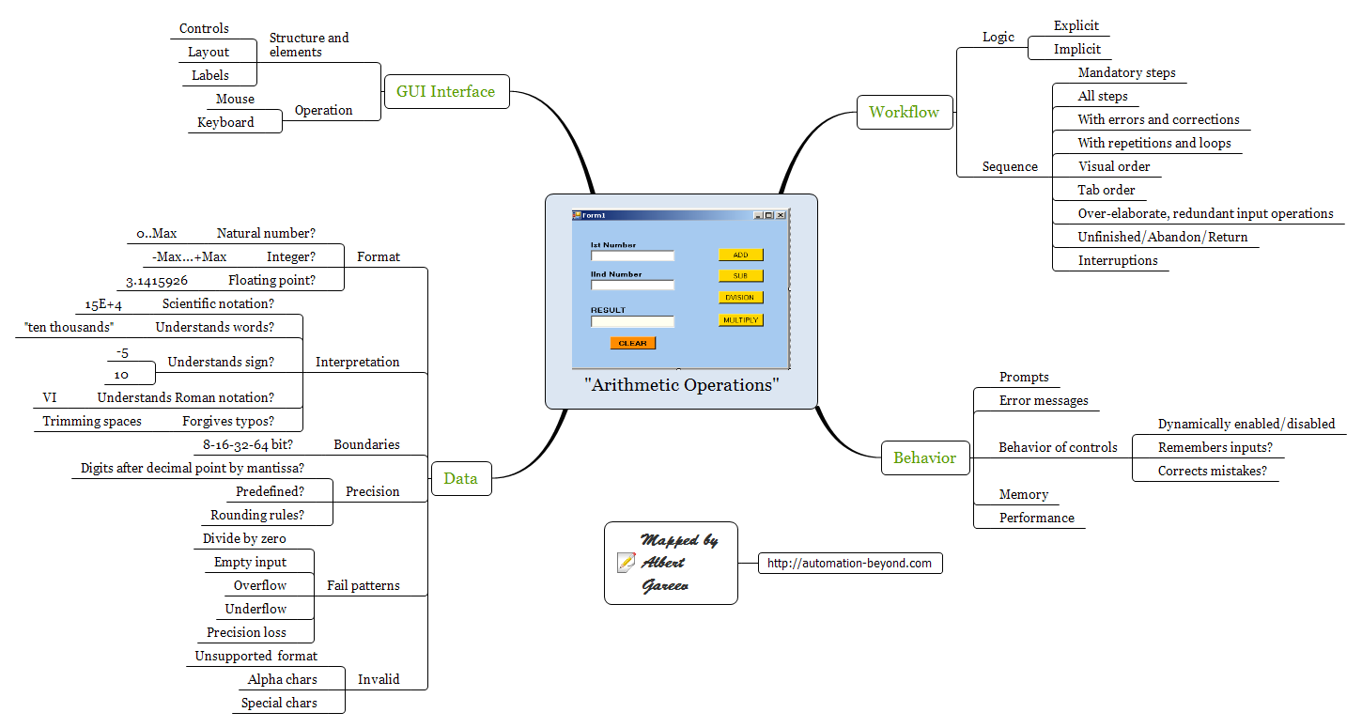
Sample scenario

Slide 21
Sample scenario
Try natural, integer, and floating point inputs to explore the format of supported values
Note: you may have a requirement explicitly stating the supported format, but that doesn’t necessarily mean that the app won’t do something odd when given other formats. So test it out!
Explore the boundaries of the numbers. 255? 65535? Or 2147483647? Don’t forget the lower boundary, whether it’s zero or −2147483647
Of course, if you’re dealing with Real number format make sure to try the respective boundary numbers
Speaking of zero. Whenever and wherever a function does any calculations, make sure to try it for each input. Zero is a special case, and division by zero is a classic error
It matters not only what data you input but how you do that. So try
Using keyboard and mouse
Typing and pasting
Editing existing values and removing the content of the fields
Input in different order
Input with interruptions and repetitions

Slide 22
White-Box Testing
... our goal is to ensure that all
statements and conditions have
been executed at least once ...

Slide 23
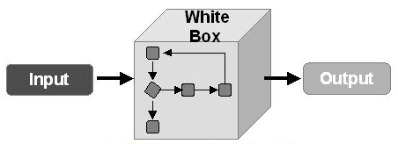
Testing model: White box testing
White box testing takes into account the internal mechanisms of a system or component.
Given knowledge of the internal workings, you thoroughly test what is happening on the inside
Close examination of procedural level of detail
Logical paths through code are tested
Conditionals
Loops
Branches
Status is examined in terms of expected values

Slide 24
Advantages of White box testing
Finds an important class of boundaries.
Yields useful test cases.
Very useful to examine and test important data structures
Useful for verification (are we building the software right)

Slide 25
Disadvantages of White box testing
Tests may have the same bugs as implementation!
Impossible to thoroughly exercise all paths
Exhaustive testing grows without bound

Slide 26
Types of testing
Six types of testing
Unit testing
Integration testing
Functional / System testing
Acceptance testing
Regression testing
Beta testing

Slide 27
Unit Testing
module
to be
tested
results
software
engineer
test cases

Slide 28

Unit testing
Testing of individual hardware or software units or groups of related units
Done by programmer(s)
Generally all white box
Verify that code does what it is intended to do at a very low structural level
Automation desirable for repeatability

Slide 29
Unit Testing
module
to be
tested
interface
local data structures
boundary conditions
independent paths
error handling paths
test cases

Slide 30
Unit Test Environment
Driver: nothing more than a “main program” that accepts test case data, passes such data to the component (to be tested), and prints
driver
interface
local data structures
Module
boundary conditions
independent paths
error handling paths
stub
stub
test cases
RESULTS
Stub: A stub or “dummy subprogram” uses the subordinate module’s interface, may do minimal data manipulation, prints verification of entry, and returns control to the module undergoing testing
Notes:
Because a component is not a stand-alone program, driver and/or stub software must often be developed for each unit test.

Slide 31

Integration testing
Testing in which software components, hardware components, or both are combined and tested to evaluate the interaction between them
Done by programmer as they integrate their code into code base
Verifies that units work together when they are integrated into a larger code base
Just because the components work individually, that does not meant that they all work together when integrated
Generally white box, maybe some black box
Automation desirable for repeatability

Slide 32
Integration Testing Strategies
Options:
• the “big bang” approach
• an incremental construction strategy

Slide 33
Top Down Integration
A
top module is tested with
stubs
B
F
G
stubs are replaced one at
a time, "depth first"
C
as new modules are integrated,
some subset of tests is re-run
D
E

Slide 34
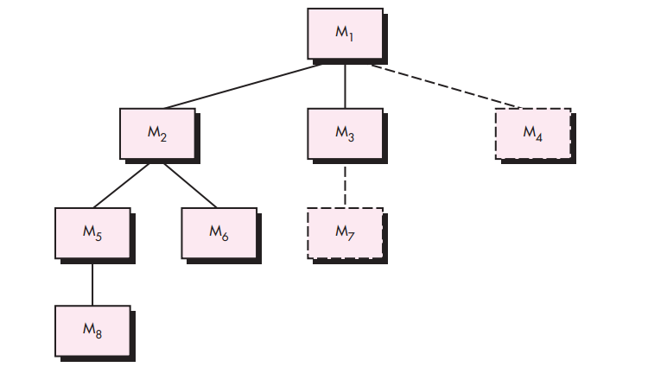
Top Down Integration
Either DFS or BFS approach

Slide 35
Bottom-Up Integration
A
B
F
G
drivers are replaced one at a
time, "depth first"
C
worker modules are grouped into
builds and integrated
D
E
cluster

Slide 36
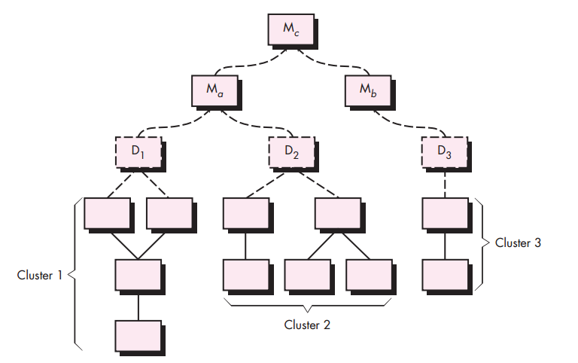
Bottom-Up Integration

Slide 37
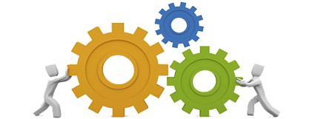
Functional testing
Testing conducted on a complete, integrated system to evaluate the system compliance with its specified requirements
Stress testing: evaluating a system beyond the limits of its specification
Performance testing: evaluating the compliance of a system with specified performance requirements.
Usability testing: evaluating the extend to which a user can learn to operation, prepare inputs for, and interpret outputs of a system.
It is recommended that this be done by external test group
Mostly black box so that testing is not ‘corrupted’ by too much knowledge

Slide 38


Acceptance testing
Formal testing conducted to determine whether or not a system satisfies its acceptance criteria (the criteria the system must satisfy to be accepted by a customer) and to enable the customer to determine whether or not to accept the system
Generally done by customer/customer representative in their environment through the GUI
Definitely black box

Slide 39
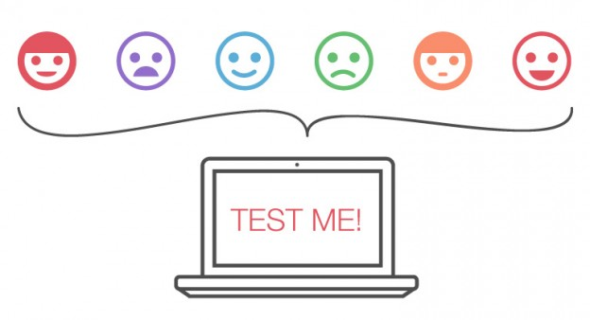
Beta testing
Organization can offer an advance partial or full version of a software package free to one or more potential users.
Users use the software as they wish, with the understanding that they will report any errors revealed during usage back to the organization.
Advantages
Identification of unexpected errors
Low costs
Wider population / environment
Disadvantages
Lack of systematic testing
Low quality error reports

Slide 40
Testing Hierarchy
Acceptance testing
Functional testing
Integration testing
Unit testing
Beta testing
Regression testing

Slide 41
Test plan
Document describing the scope, approach, resources, and schedule of intended testing activities
A test plan identifies
test items
features to be tested
Testing tasks
who will do the testing
any risks requiring contingency plans
Test throughout the development cycle
Write the test plan early in the development cycle
If you wait until the end of the cycle, you might be in a very chaotic, hurried environment

